Slide 1
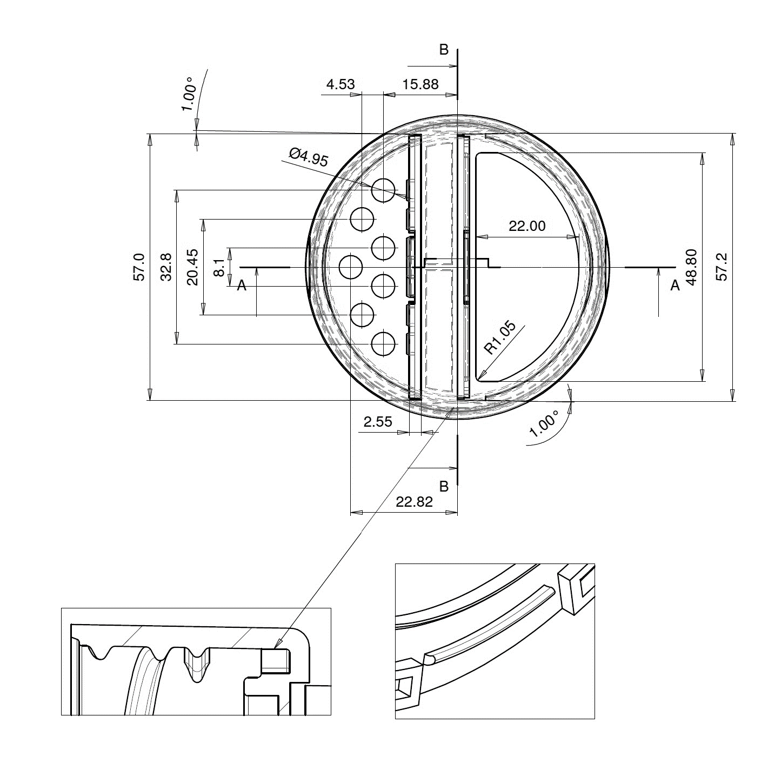
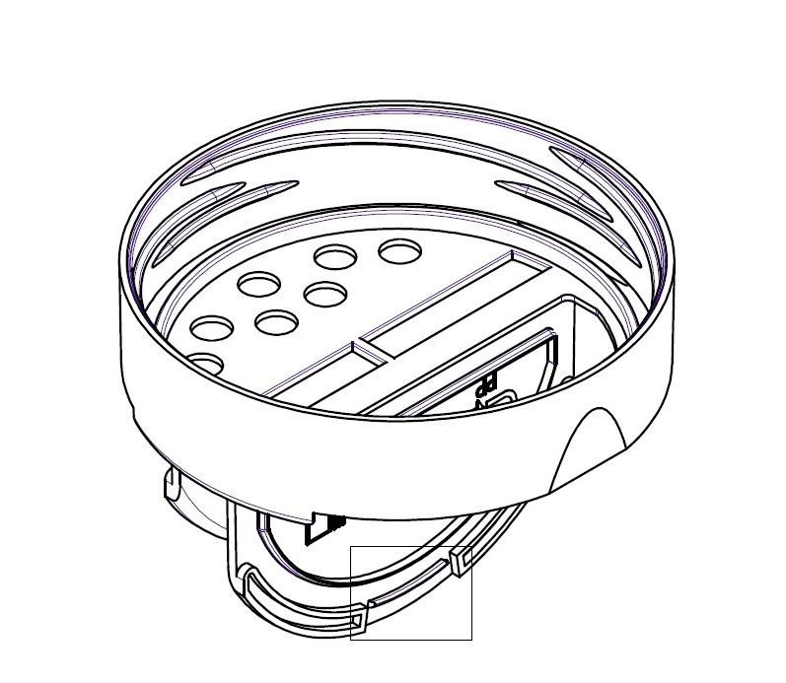
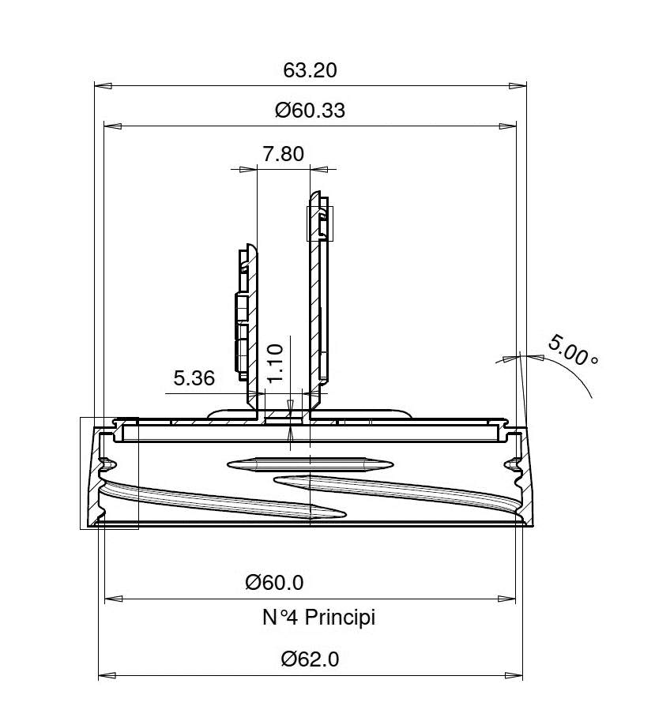
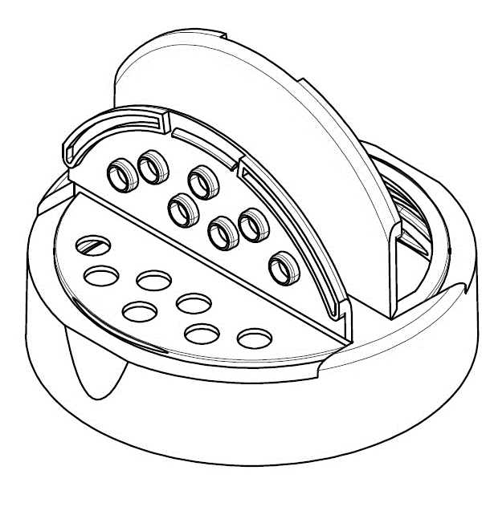
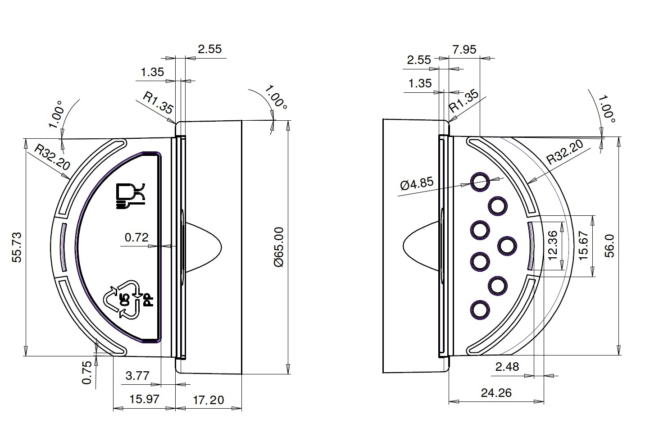
Article Name | 63RTS 4-start Twist-off 63 mm Flapper Cap
Customer Article No. | None
Trypet Article ref. | K5B.63RTS
Drawing Date | 29.04.2009.
Pitch | 16.00 mm
Height | 17.20 +/- 0.20 mm
Diameter (outer) | 65.00 +/- 0.30 mm
Other Tolerances | According to H12, h12, +/-IT12/2
Weight | 9.90 +/ - 0.50 g
Neck finish | 63RTS 4-start
This document in design and detail is the property of SIA Trypet and is not to be used or reproduced by unauthorized persons.
 | Name /Signature | Date
Confirmed by project manager | Vadim Fedyanin | 23/03/2016
Confirmed by Quality Control | Valentina Schegolevatiha

